Slide 1



COMP5206 Information Technologies and Systems
Personal Health Assistant Application Based on Virtual Assistant Technology
—— Koala Health Assistant
●Presenters Name | 470090419 Mingming Zhao 470090453 Rongbing Yan 480064336 Lina Fu 480090900 Suwan Zhu 480099589 Fan Gao 470132797 Xiang Li
Notes:
更多模板下载地址：http://www.pptvzaixian.com/shop/view28111.html（复制链接到浏览器打开）

Slide 2
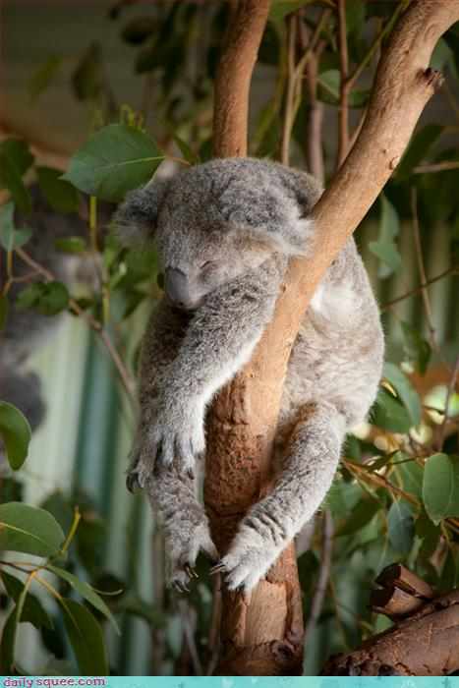
CONTENTS
01
Problem Statement
02
Customer Segments and Unique Value
03
Solution and Unfair Advantage
04
Channels
05
Cost and Revenue
Notes:
更多模板下载地址：http://www.pptvzaixian.com/shop/view28111.html（复制链接到浏览器打开）

Slide 3
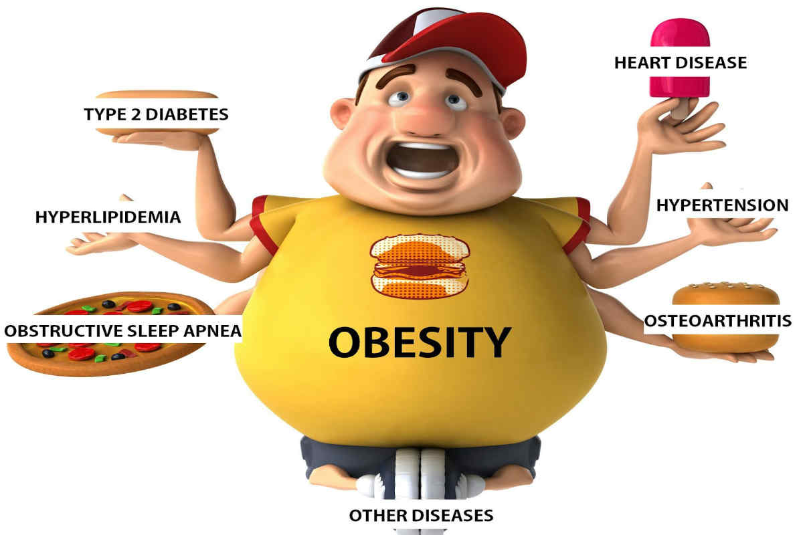

Problem Statement
Market Prospects
Australian Institute of Health and Welfare, 2017
30%
40%
Nearly of Australian adults are overweight or obese.
Nearly of Australians facing more than two chronic diseases at age and above.
45
Health, A. I. o., & Welfare. (2017). Weight loss surgery in Australia 2014–15: Australian Hospital Statistics.

Slide 4
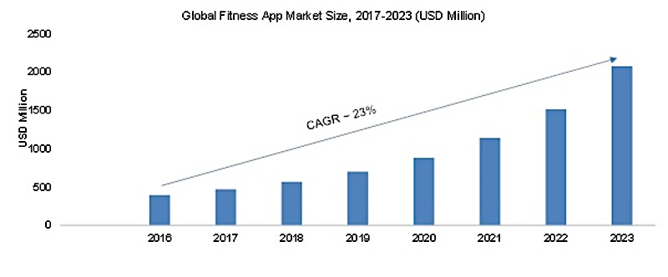
Problem Statement
Market Prospects
Global Fitness App Market Size, 2017-2023 (USD Million)
http://ezproxy.library.usyd.edu.au/login?url=https://search-proquest-com.ezproxy1.library.usyd.edu.au/docview/1891728540?accountid=14757

Slide 5
Problem Statement
Key Problems
Here are 4 things people hate in fitness apps after using them for a while.
01
02
Inconvenient record operation
Losing motivation due to unsupervised
Manually enter all information
Ask users to take the initiative
03
04
Lack of social interaction support
Complex features cause high cost of use
No convenient and active community
Professional features and wearable devices

Slide 6

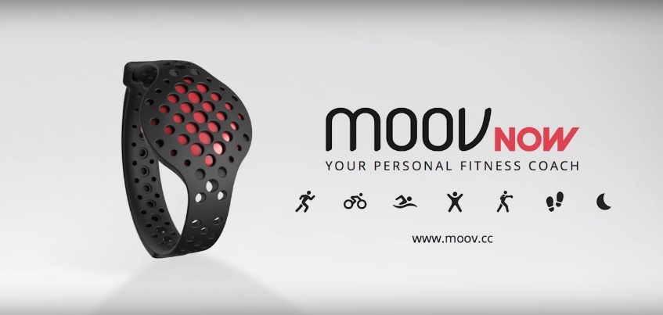

Problem Statement
MyFitnessPal
A
Existing Products
B
Moov Now
Barcode scanners
C
Strava
Real-time voice guidance
Facebook in the fitness apps

Slide 7
Customers Segments
Lack of perseverance | According to Silverman, R. E. (2003, Jul 16), many of fitness members go to the gym less than five times a month.
Concerns about complex health data input. | Gardner, A. K. (2000) describes that most of the current fitness and health applications require users to manually record various data.
Too many professional fitness functions. | Guo, R. (2015) claims that many people think that these professional features are not useful to them.
Soeriaatmadja, K. (2017). Consumer Tribe dan Industri Gaya Hidup di Bandung, Indonesia. Jurnal Keamanan Nasional, 3(1), 149-166.
Gardner, D. K., Lane, M., Stevens, J., Schlenker, T., & Schoolcraft, W. B. (2000). Blastocyst score affects implantation and pregnancy outcome: towards a single blastocyst transfer. Fertility and sterility, 73(6), 1155-1158.
Guo, L., Sharma, R., Yin, L., Lu, R., & Rong, K. (2017). Automated competitor analysis using big data analytics: Evidence from the fitness mobile app business. Business Process Management Journal, 23(3), 735-762.

Slide 8
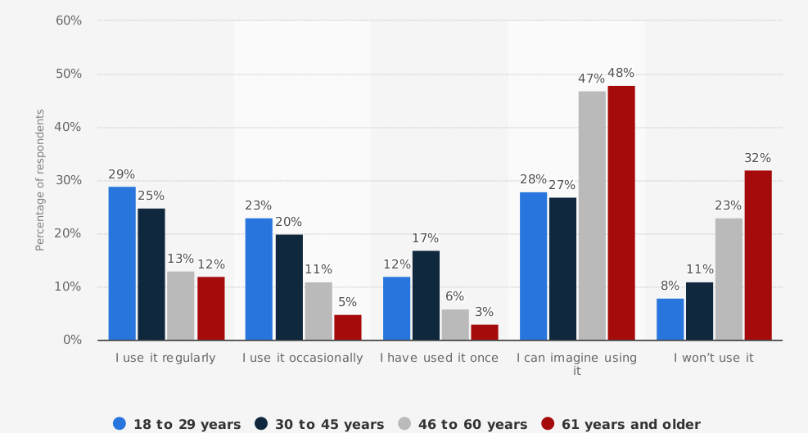
Customers Segments
Our ideal user as a middle – aged worker with health needs but not professional fitness.
Percentage of U.S. adults who use an app to track their fitness as of 2017, by age
https://www.statista.com/statistics/699197/us-adults-that-use-an-app-to-track-their-fitness-by-age/

Slide 9
Unique Value Proposition
Our slogan: Less is more.
Our app focus on:
Helping people understand their diet, control the frequency of exercise, and help users develop good eating habits and shape healthy bodies to avoid various diseases caused by health problems.
Function | Explanation
Concise and suitable | Diet (record daily food intake and calculate nutrient intake) and exercise (only walking and running).
Active voice interaction | Reminds users about their exercise in time and answers user questions
Social environment | Allows people communicate with friends and share their moments about exercises and diet

Slide 10
Minimum Viable Product
Dietary Aspect
Sport Aspect
A
B
Add and modify food intake by voice & Get diet information such as calories
Calculate running and walking information.
Voice reminds
D
Analyse
C
Analyse daily calorie intake and consumption and suggest the fitness recommendation.
Active voice reminds you of your daily fitness.

Slide 11

Solution
Does not need wake-up words to wake up.
Supports active prompts and communicates with the user.
01
Actively Communicate
ASK
Answer
ASK
Answer

Slide 12

Solution
02
Voice Input
Automatically record a variety of information.
Avoid laziness, maintain long-term interest.
An active virtual assistant is like a private secretary.

Slide 13
Solution
03
Community Supports
View the sports data of friends, users can like and comment.
04
Cut complex features
Simple function.
lower price.
Power consumption is very low.

Slide 14
Unfair advantage
Active Voice Interaction Technology
Provides the active reminder function
More intelligent and efficient.
Automatic Speech Recognition.
Multi-channel signal processing, ‘6+1’ microphone array;
Speech separation when multiple people speak.
Community Function
Promote the enthusiasm of users to exercise.
Increase the interaction between friends.

Slide 15

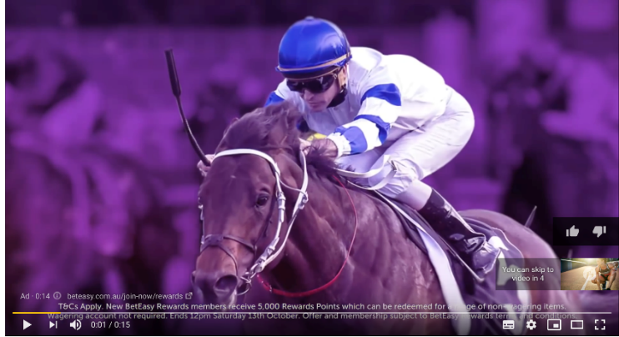
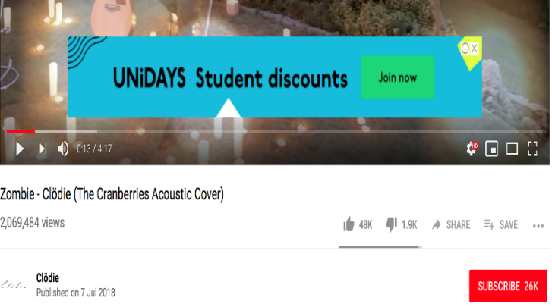
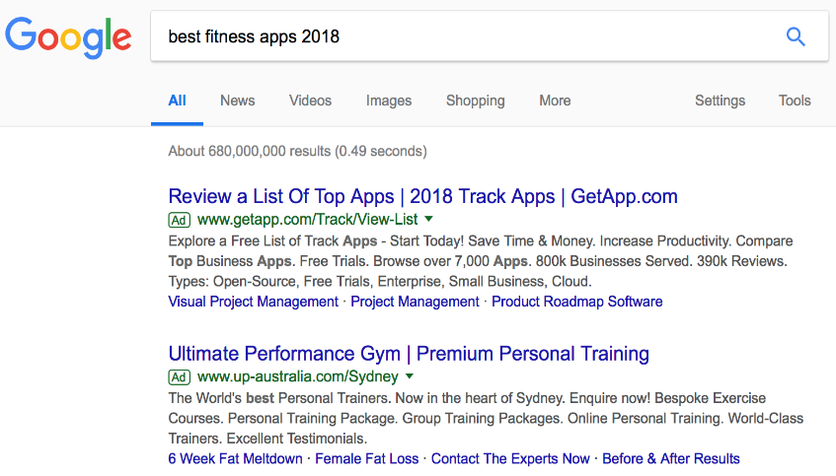
Channels

Slide 16
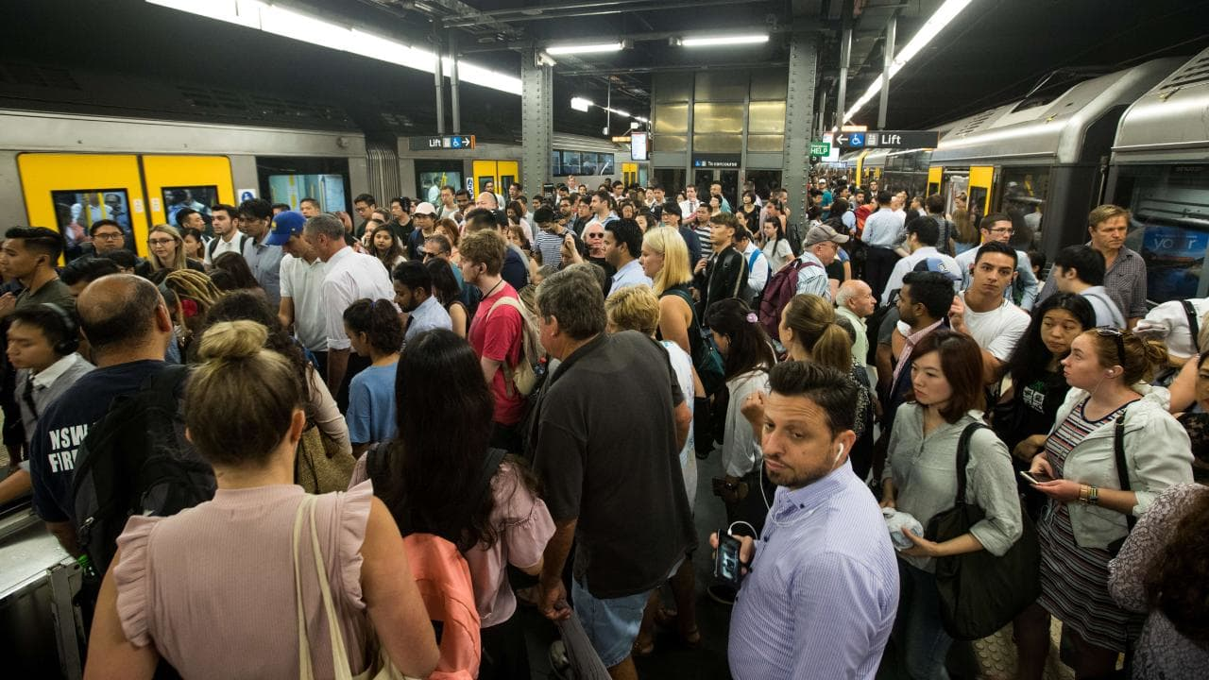
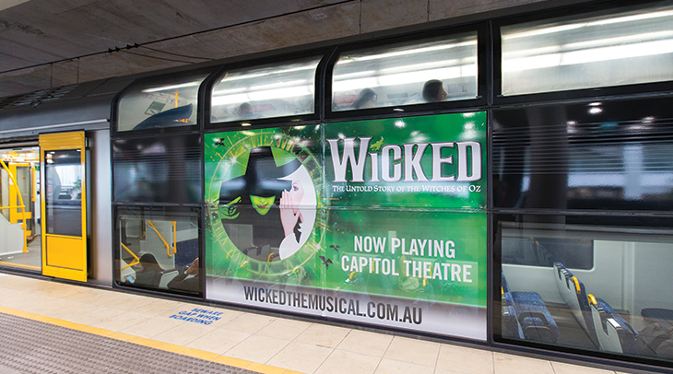
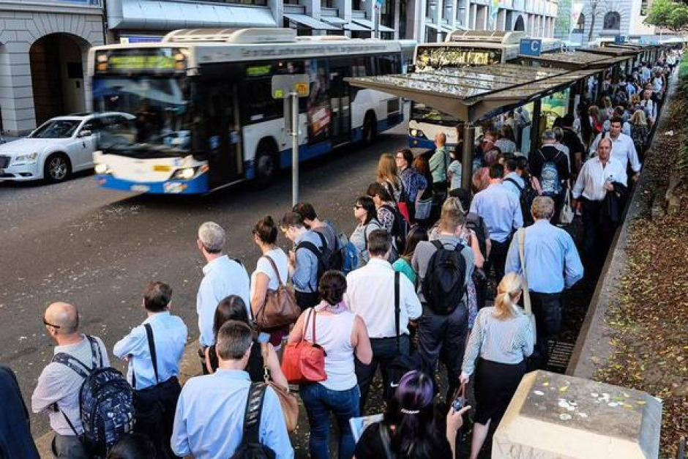
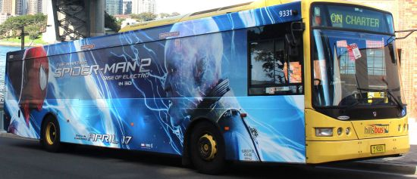
Channels

Slide 17




Cost
Marketing
Technical Resource
Cloud Service
Total Cost
1st Year | $ 2,010,000
2nd Year | $ 2,800,000
3rd Year | $ 3,800,000

Slide 18




How Do We Make Money?
Advertising
Traditional E-Commerce
Premium Version fee
Course & Recipe
Sell
Measuring
Equipment
1.Full launch-screen
2.banner
3.Interstitial
Recipe
+
Body-building class
$ 30/year

Slide 19
Specific Profit
Advertising
Ad. type | price | Estimated client | Estimated profit
Full launch-screen | $ 1500 per day | 10 | 1500*365= $ 0.54m
banner | $ 300 per day | 20 | 300*365=$ 0.1m
Interstitial | $ 700 per day | 5 | 700*365=$ 0.7m

Slide 20
Specific Profit
E-commerce
150*10%*500000 = 0.75M $/year
Buying Possibility
Annually
Cost Per Customer
Potential Buyers

Slide 21
Specific Profit
Channel Fee
category | Access price | Potential client | Potential profit
Gym Class | $ 3.0 each | 0.01 M | $ 0.03 M
Recipe | $ 2.0 each | 0.03 M | $ 0.06 M

Slide 22
Specific Profit
Annually Fee
Version | Annually Access fee | Potential users | Potential profit
Standard | 0 | $ 0.08 million | 0
premium | $30.0 per year | $ 0.02 million | $ 0.6m

Slide 23
Revenue
Expected Increase 20% each year

Slide 24
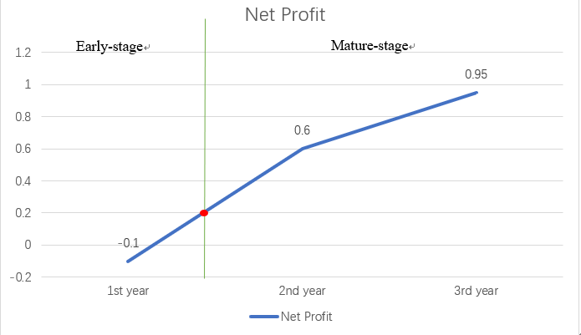
BreakEven
14 months

Slide 25



Key-Matric
1 million times
0.1 million Premium users
Retention Rate over 70%

Slide 26
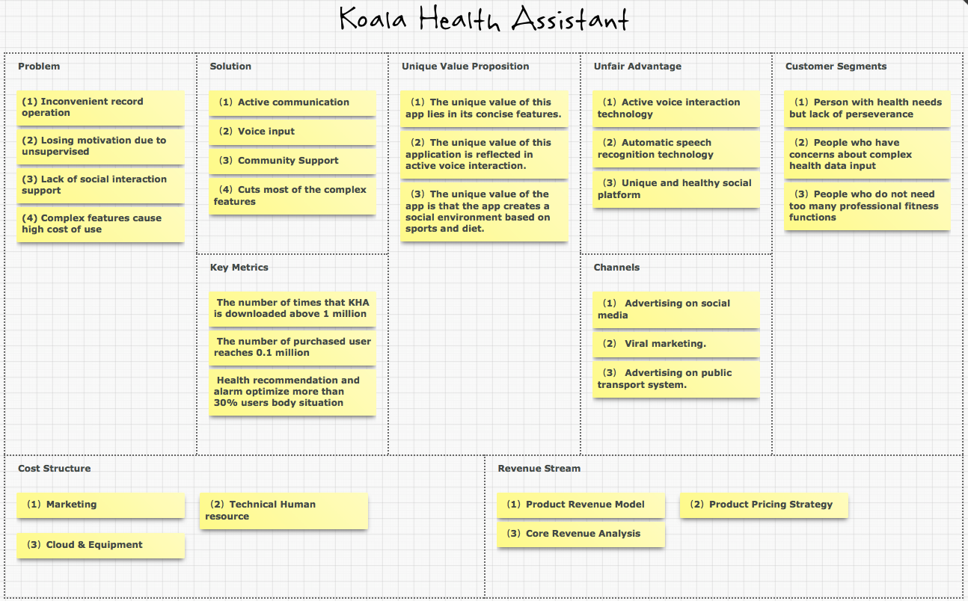

Slide 27



COMP5206 Information Technologies and Systems
Notes:
更多模板下载地址：http://www.pptvzaixian.com/shop/view28111.html（复制链接到浏览器打开）

